Slide 1
Get into IoT with Windows 10 IoT Core
Harold Pulcher
pulcher@pulcher.biz
@haroldpulcher
https://www.youtube.com/user/hpulcher
https://github.com/pulcher/iot-demos

Slide 2
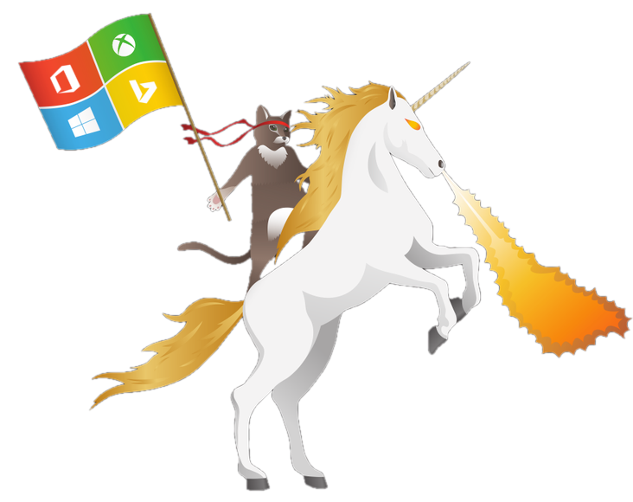
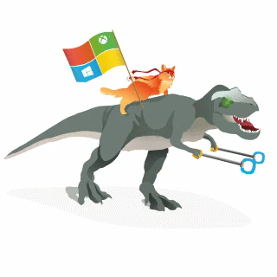
Become a Windows Insider!
https://insider.windows.com/

Slide 3

Internet of Things
20 billion devices
Metcalf’s Law
Development is easy
Hardware is cheap

Slide 4
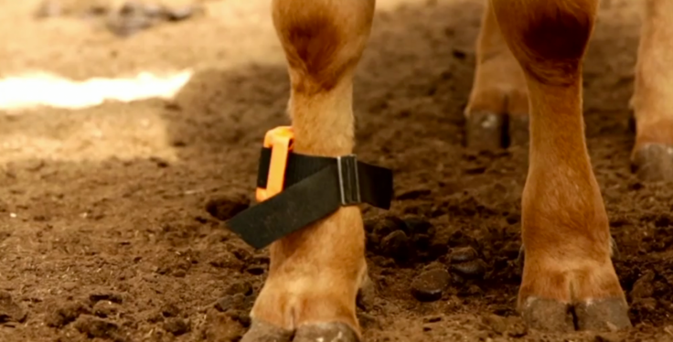
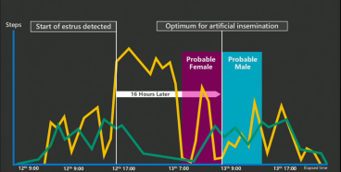
Connected Cow
http://www.youtube.com/embed/oY0mxwySaSo?autoplay=1

Slide 5
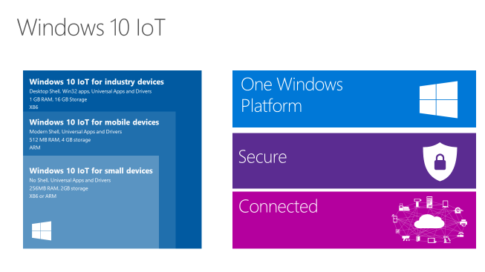
Window 10 IoT core

Slide 6

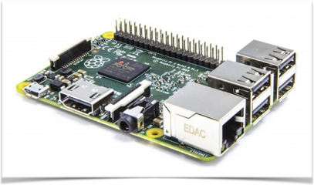
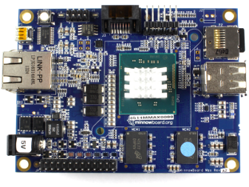

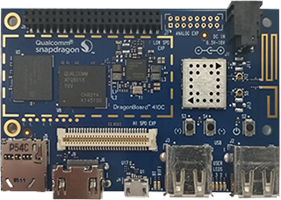
Devices
MinnowBoard Max
http://www.minnowboard.org
Raspberry Pi 2/3
http://www.raspberrypi.org
DragonBoard 410c
https://developer.qualcomm.com/

Slide 7
What do you need?
Windows 10
Visual Studio 2017
https://developer.microsoft.com/en-us/windows/iot/GetStarted
Raspberry Pi 3
5V micro USB power supply
8GB(min) class 10 micro SD card <- spend money on a good one!
HDMI cable
USB Mouse and Keyboard

Slide 8
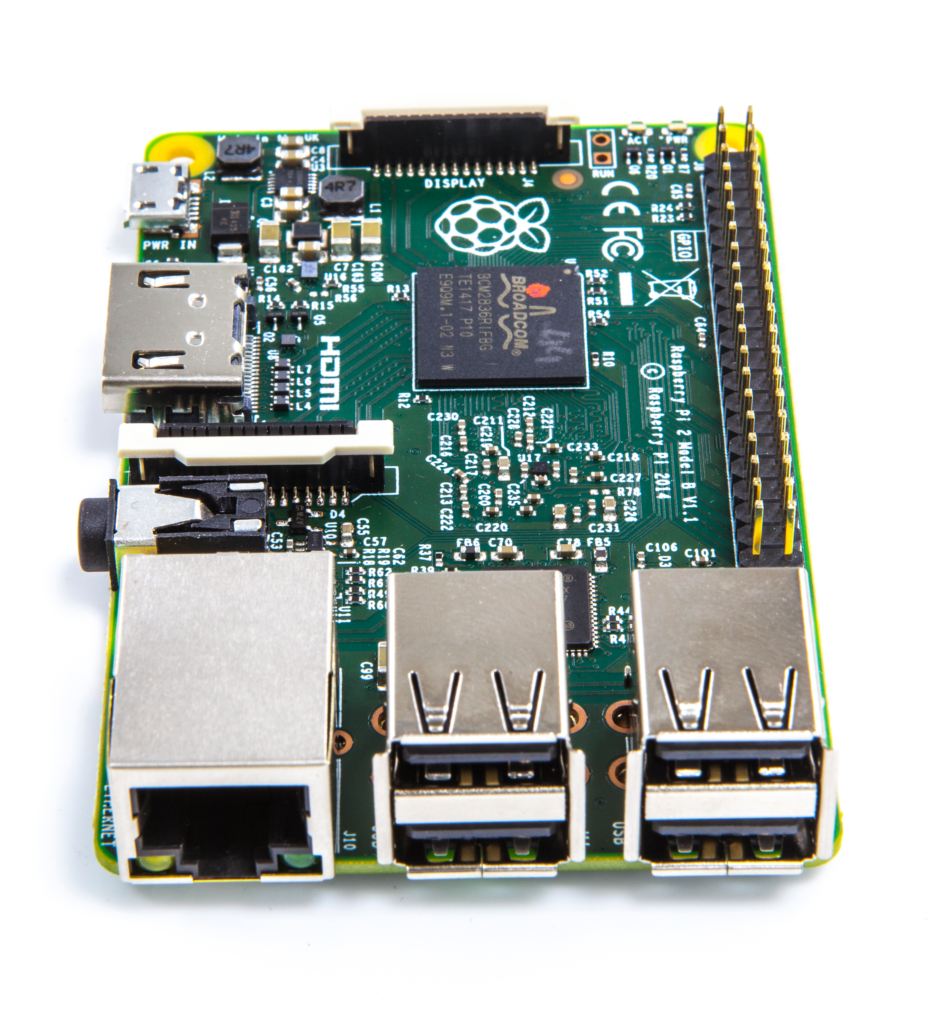
Raspberry Pi 3
1.2 GHz Quad Core Broadcom BCM2837 64bit CPU
1GB Ram
BCM43438 wireless LAN and BLE
4 USB 2 ports
HDMI
GPU
40 Pin GPIO
Ethernet

Slide 9
Enough already! How do I do this!
https://developer.microsoft.com/en-us/windows/iot/Docs/GetStarted/rpi3/sdcard/stable/GetStartedStep1.htm

Slide 10
Dashboard Demo

Slide 11
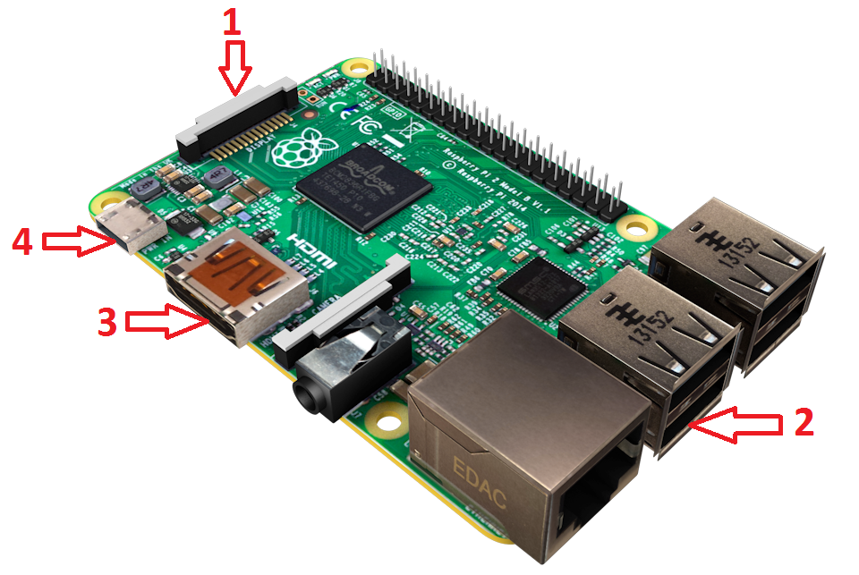
hook up the board

Slide 12
If everything goes right…..

Slide 13
So how do we talk to this thing?
Though the DashBoard
http://<ip address>:8080
Powershell
ssh
ftp

Slide 14
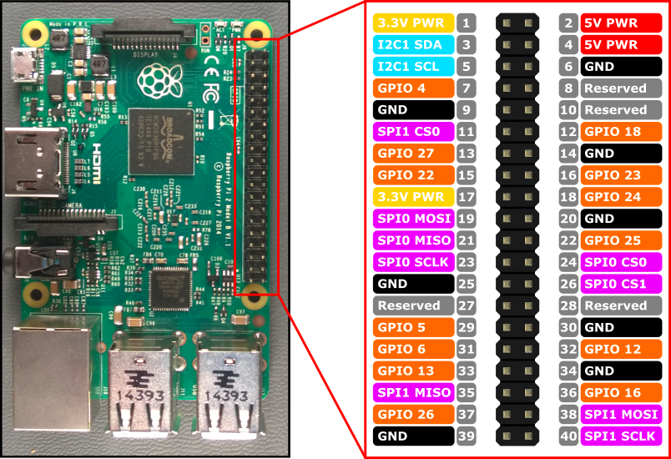
What is this GPIO thing?

Slide 15
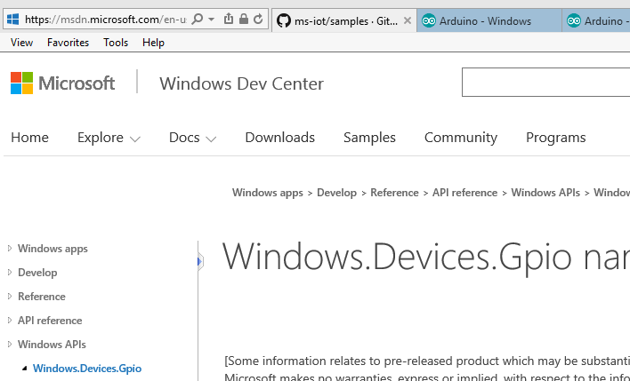
The API

Slide 16
Stop! Demo time…

Slide 17
Links
https://dev.windows.com/en-us/iot
https://insider.windows.com/
https://developer.microsoft.com/en-us/windows/iot/Docs/GetStarted/rpi3/sdcard/stable/GetStartedStep1.htm
https://developer.microsoft.com/en-us/windows/iot/docs/powershell
https://www.hackster.io/pulcher

Slide 18
https://msdn.microsoft.com/en-us/library/windows/apps/xaml/windows.devices.gpio.aspx?f=255&MSPPError=-2147217396

